Slide 1
Theme
Today we will:
Learn how to identify the “theme” of a story
Learn how to support our theme by showing evidence.

Slide 2
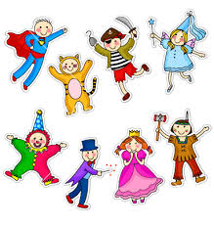
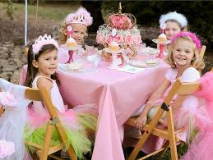
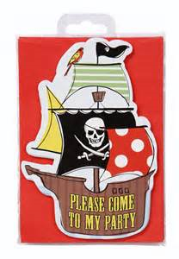
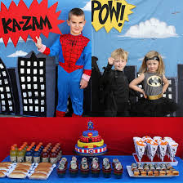
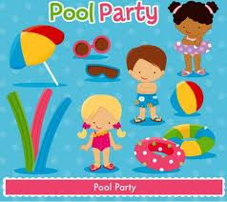
“Theme” parties
Costume party
Princess party
Superhero party
Pool party
Pirate party

Slide 3
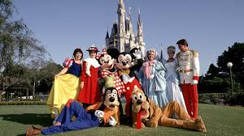
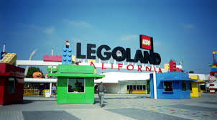
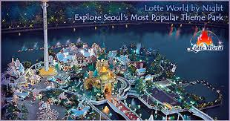
“Theme” parks
Disneyworld
Seaworld
LegoLand
LotteLand

Slide 4
What is a theme?
A theme is a
_______________ idea
A theme is shown through the character’s actions: If a character works hard, the author might be trying to tell us to __________ __________, too!
A theme is what an author (or party host or theme park owner ☺ ) wants us to know about a place: I know that if I go to a pirate party I should wear a ______________ costume!
Synonyms for “theme”:
“main idea”
“author’s message”
moral
subject
topic

Slide 5
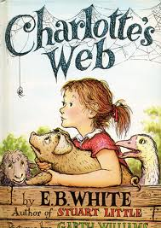
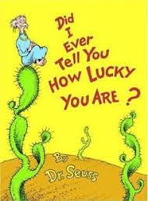
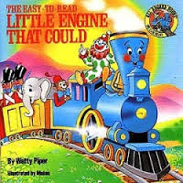
What are some examples of story “themes”?
Love
Loyalty
Perseverance (Work hard!)
Be brave
Be thankful

Slide 6
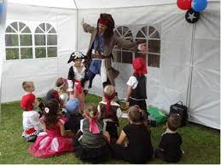
We support (try to prove) our idea of what the theme is using evidence.
What is some evidence that this is a pirate party?

Slide 7
What is some evidence that they are at Seaworld?

Slide 8
What is some evidence that “The Little Engine that Could” is about perseverance (working hard/trying again and again)?
Clues from the title: The word “could” is used and it means that you can do something! | Clues from the characters: The little engine says “I think I can, I think I can” many times.
Clues from the setting: The story takes place on a big, steep hill that is very difficult for the little train to climb. | Clues from the events: The little engine keeps going even though it is difficult, and he finally makes it!

Slide 9
Now, you will find the themes for several more books & support your ideas with evidence!
Get ready to:
1: Listen to “Wanda’s Roses” and help Ms. Tutino complete the theme chart about it.
2: Identify the themes of some other stories we have read & explain your ideas with evidence. (theme cards/partners)
3: Complete a “theme” & “evidence” exit ticket!

